Slide 1
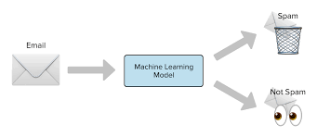
SPam Detection Classifier project
Submitted
By
Subhashchandra Pandey
Internship -29

Slide 2
AGENDA
Introduction​
Problem Statement
Business Goal
Technical Requirement
Exploratory Data Analysis (EDA)
Data Description
Visualization
Data Pre-Processing
Build Model
Saved Best Model
Summary​

Slide 3
Introduction
The SMS Spam Collection is a set of SMS tagged messages that have been collected for SMS Spam research. It contains one set of SMS messages in English of 5,574 messages, tagged according being ham (legitimate) or spam.
Spam Detector is used to detect unwanted, malicious and virus infected texts and helps to separate them from the nonspam texts. It uses a binary type of classification containing the labels such as ‘ham’ (nonspam) and spam. Application of this can be seen in Google Mail (GMAIL) where it segregates the spam emails in order to prevent them from getting into the user’s inbox.
A collection of 5573 rows SMS spam messages was manually extracted from the Grumbletext Web site. This is a UK forum in which cell phone users make public claims about SMS spam messages, most of them without reporting the very spam message received. The identification of the text of spam messages in the claims is a very hard and time-consuming task, and it involved carefully scanning hundreds of web pages.

Slide 4
Business Goal
A subset of 3,375 SMS randomly chosen ham messages of the NUS SMS Corpus (NSC), which is a dataset of about 10,000 legitimate messages collected for research at the Department of Computer Science at the National University of Singapore. The messages largely originate from Singaporeans and mostly from students attending the University. These messages were collected from volunteers who were made aware that their contributions were going to be made publicly available.

Slide 5
Technical Requirements
We need to build a machine learning model. But before model building do all data preprocessing steps involving NLP. Try different models with different hyper parameters and select the best model.
Follow the complete life cycle of data science. Include all the steps like:
1. Data Cleaning
2. Exploratory Data Analysis
3. Data Preprocessing
4. Model Building
5. Model Evaluation
6. Selecting the best mode

Slide 6
Exploratory Data Analysis (EDA)
Checked Top 5 rows of dataset
Checked Total Numbers of Rows and Column
Checked All Column Name
Checked Data Type of All Data
Checked for Null Values of both dataset
Checked total number of unique value
Checked Information about Data
Dropped irrelevant features
Handled NULL values
Handled duplicate values

Slide 7

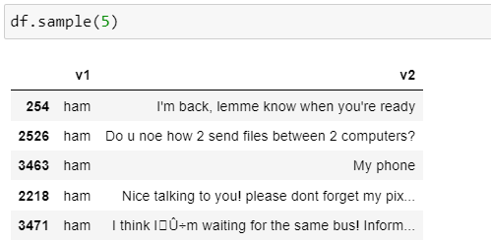
Data Description of Data-set
The dataset contains 5572 records (rows) and 5 features (columns).
Removed 3 unwanted columns.

Slide 8
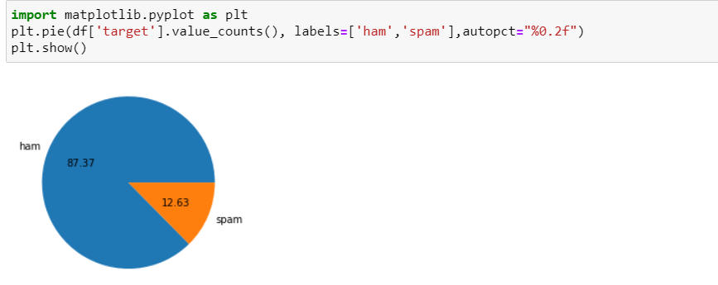
Data Visualization

Slide 9
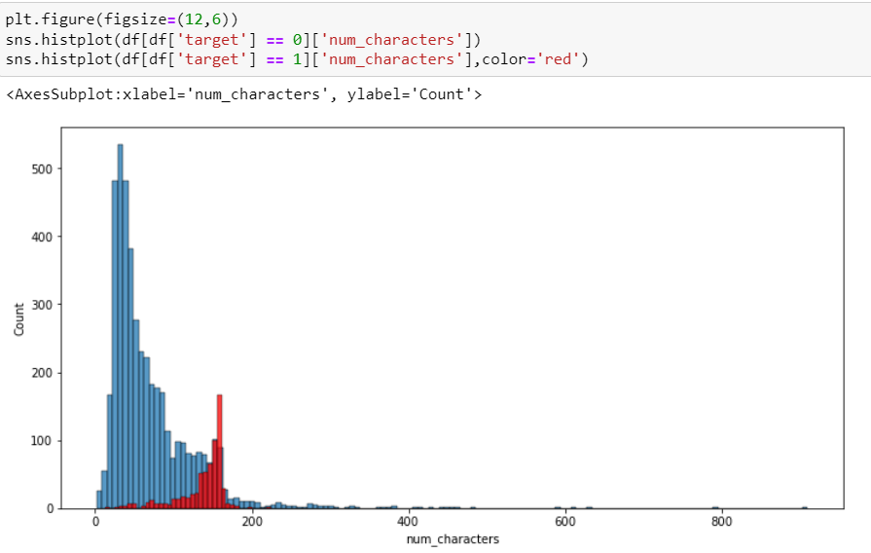


Slide 10
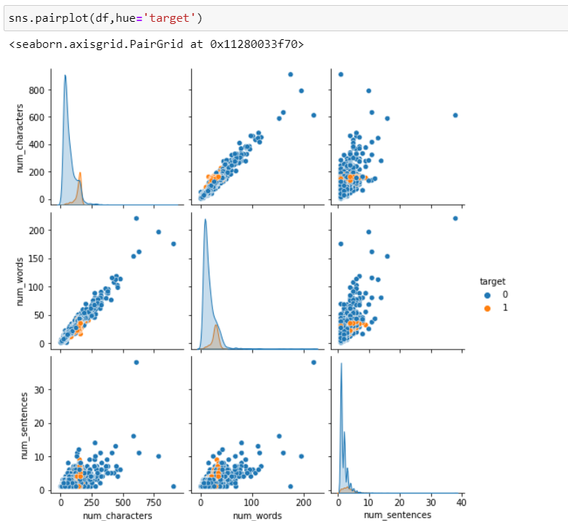

Slide 11
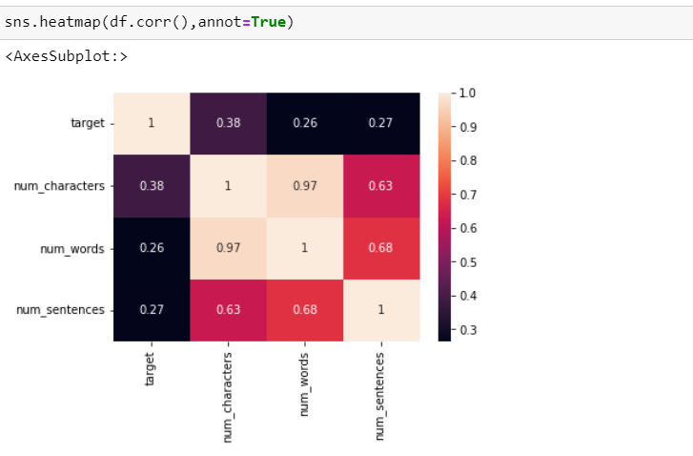

Slide 12

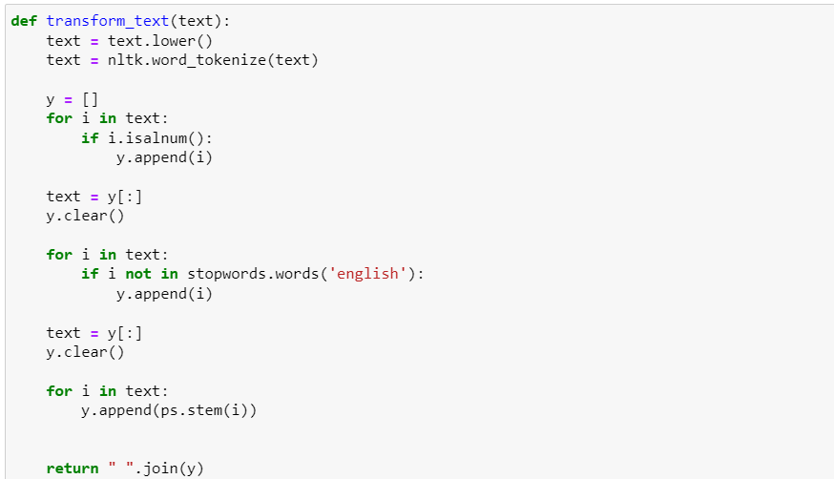

Slide 13
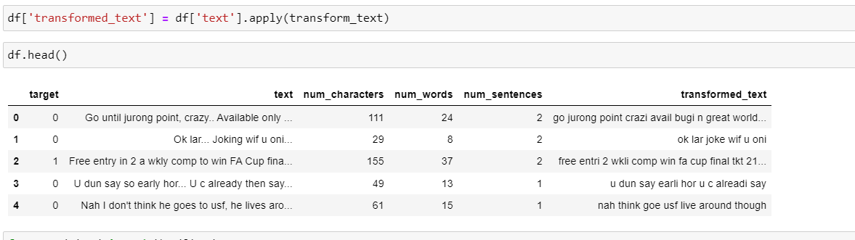

Slide 14

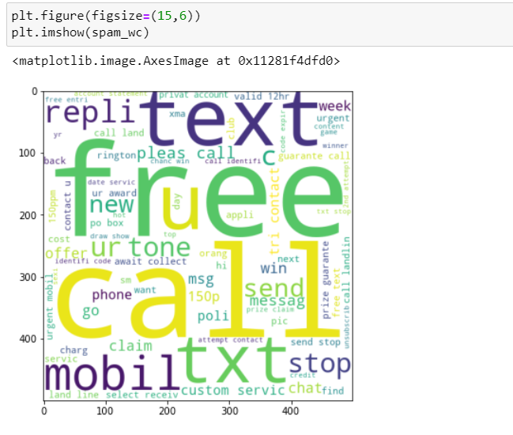

Slide 15
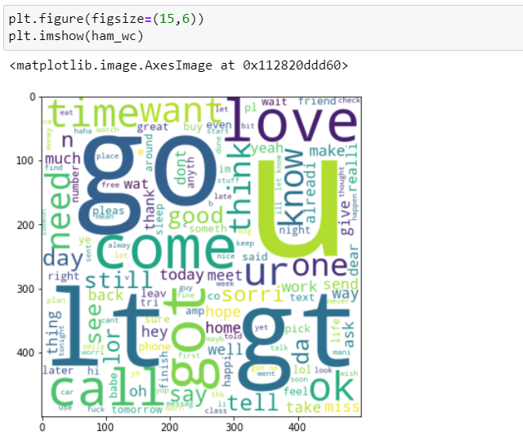

Slide 16

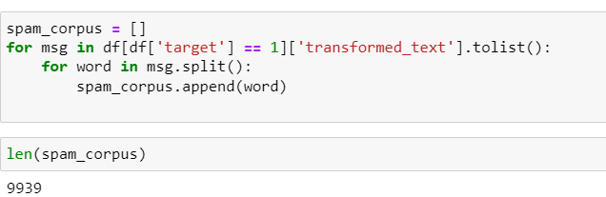
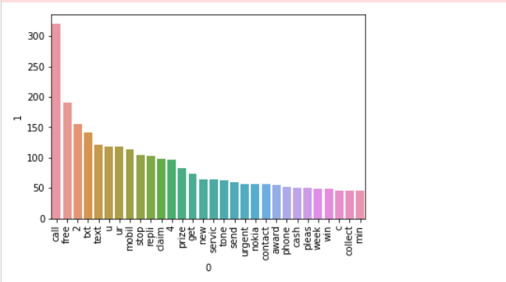

Slide 17
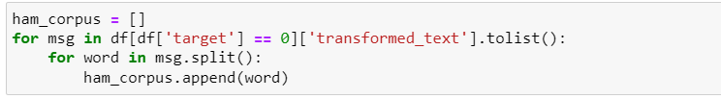
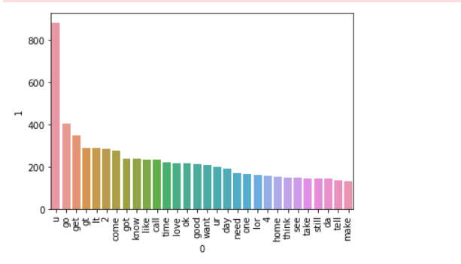

Slide 18
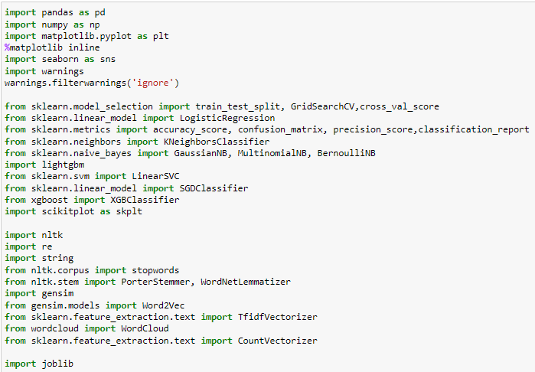
Tools, Libraries and Packages used:

Slide 19

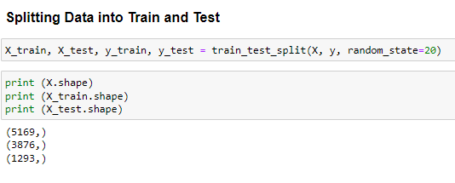
Testing of Identified Approaches (Algorithms)
Logistic Regression
Linear Support Vector Classifier
Bernoulli NB
Multinomial NB
SGD Classifier
XGB Classifier

Slide 20
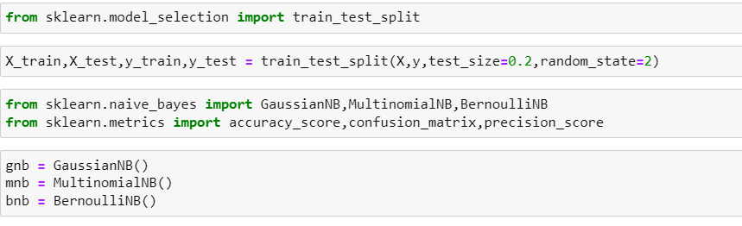

Slide 21
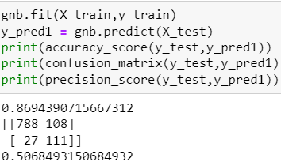
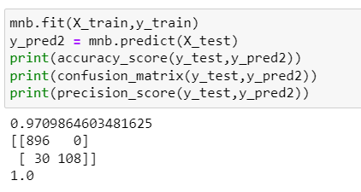
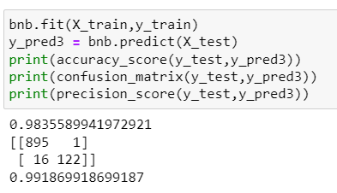

Slide 22
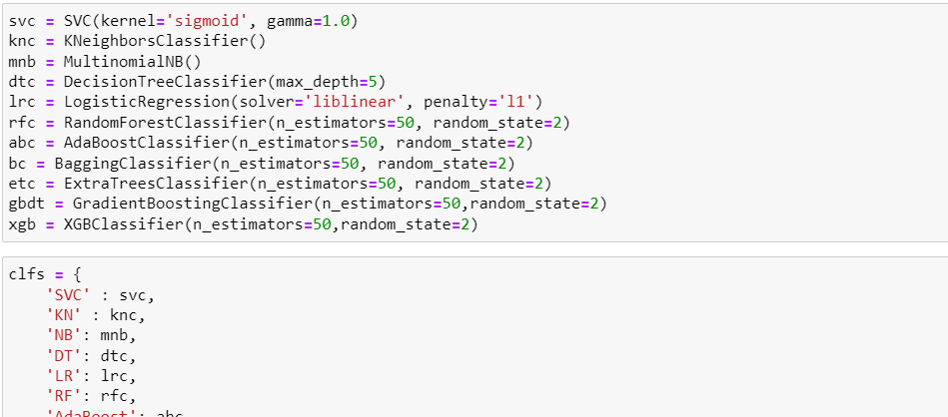

Slide 23
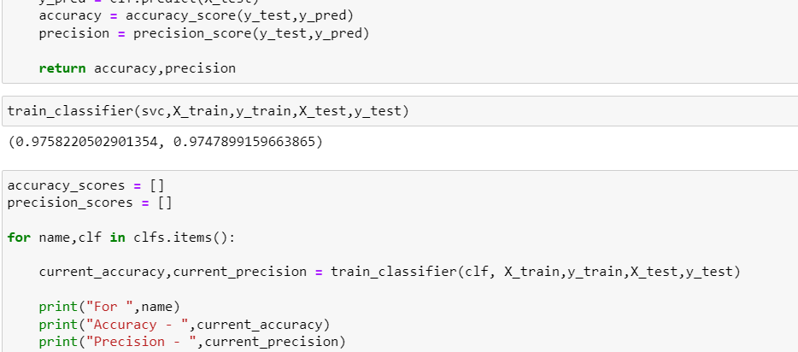

Slide 24
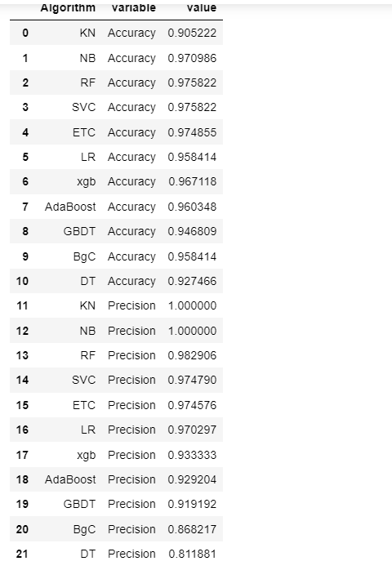
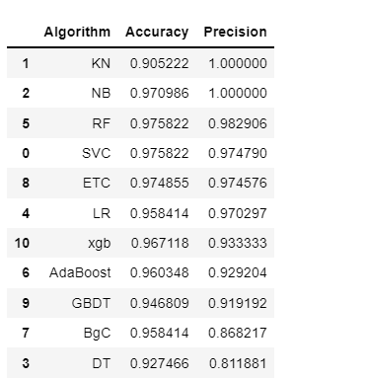

Slide 25
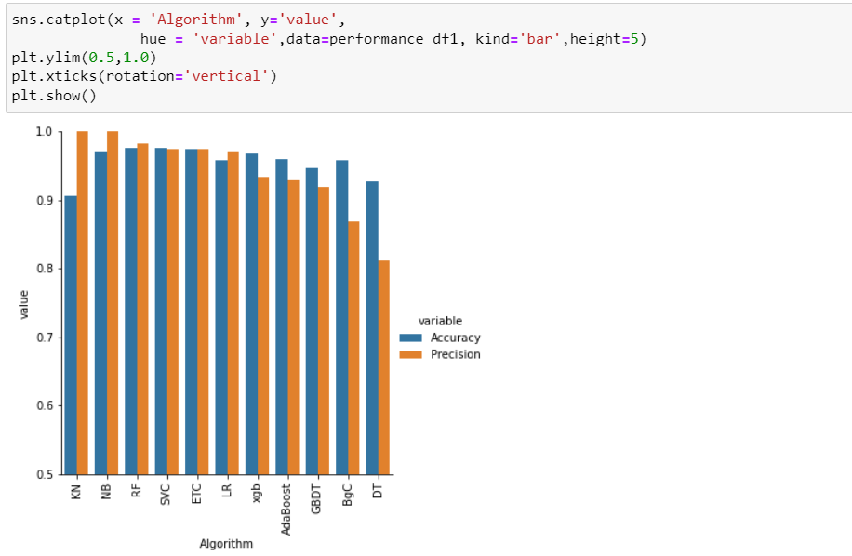

Slide 26
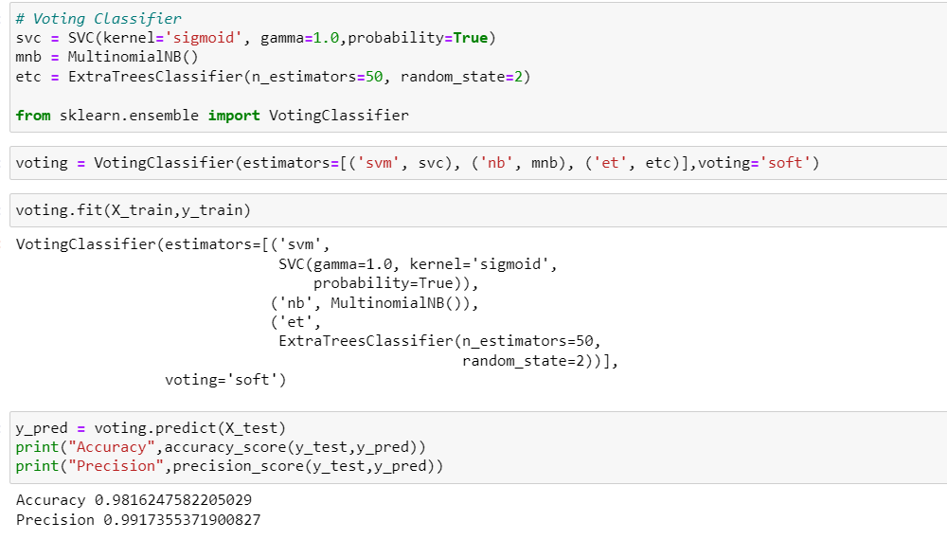

Slide 27

Final Procedure: 1. Saving the model

Slide 28
SUMMARY
In this project we have detected spam and ham messages that have been collected for SMS Spam research. Then we have done different text process to eliminate problem of imbalance. By doing different EDA steps we have analyzed the text.
We have checked frequently occurring words in our data as well as rarely occurring words. After all these steps we have built function to train and test different algorithms and using various evaluation metrics we have selected Linear-SVC for our final model.
Finally, by doing hyperparameter tuning we got optimum parameters for our final model. And finally, we got improved accuracy score for our final model.

Slide 29
THANK YOU

